Slide 1
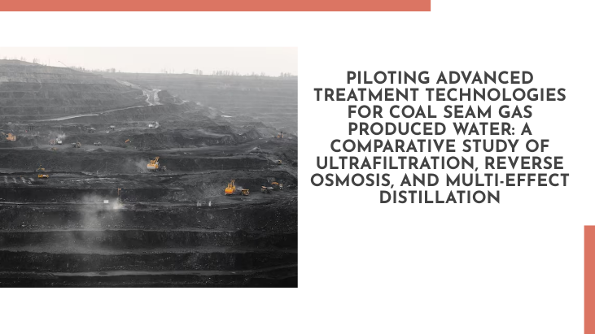
A PILOT STUDY ON COAL SEAM GAS WATER FILTRATION
DESIGN CREDIT COURSE
UNDER VIKKY ANAND

Slide 2
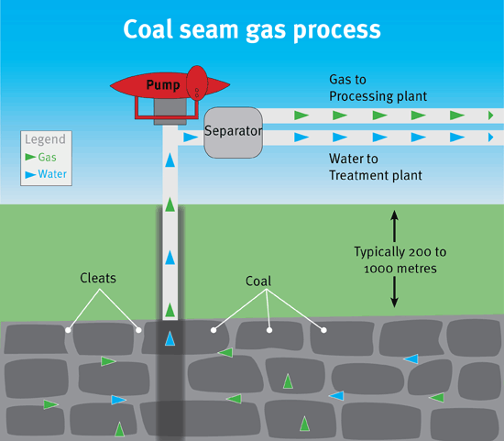
INTRODUCTION
COAL SEAM GAS IS ALSO KNOWN AS COAL BED METHANE.
IT IS A FORM OF NATURAL GAS
30% OF THE AUSTRALIAN DOMESTIC SUPPLY WILL RELY ON CSG BY 2030.
CSG DEVELOPMENTS IN NEW SOUTH WALES & QUEENSLAND WILL CONTRIBUTE 78% OF NATURAL GAS RESERVES IN EASTERN STATE.

Slide 3
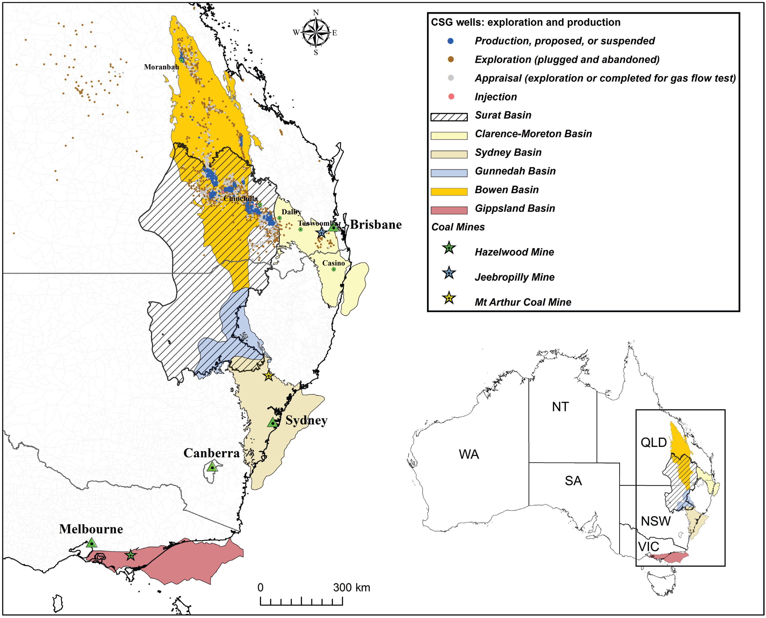
IMPACT OF CSG
NATURAL GAS ONLY PRODUCES 50% CO2, 33% N(O)n, 1% OF S(O)n
CSG EXIST IN ALMOST EVERY UNDERGROUND COAL.
CSG USAGE OVER THE YEARS WILL LESSEN THE IMPACT OF FOSSIL FUEL ON GLOBAL WARMING.
CSG PRODUCTION ALSO INVOLVE CO-PRODUCTION OF WATER KNOWN AS CSG PRODUCED WATER.

Slide 4
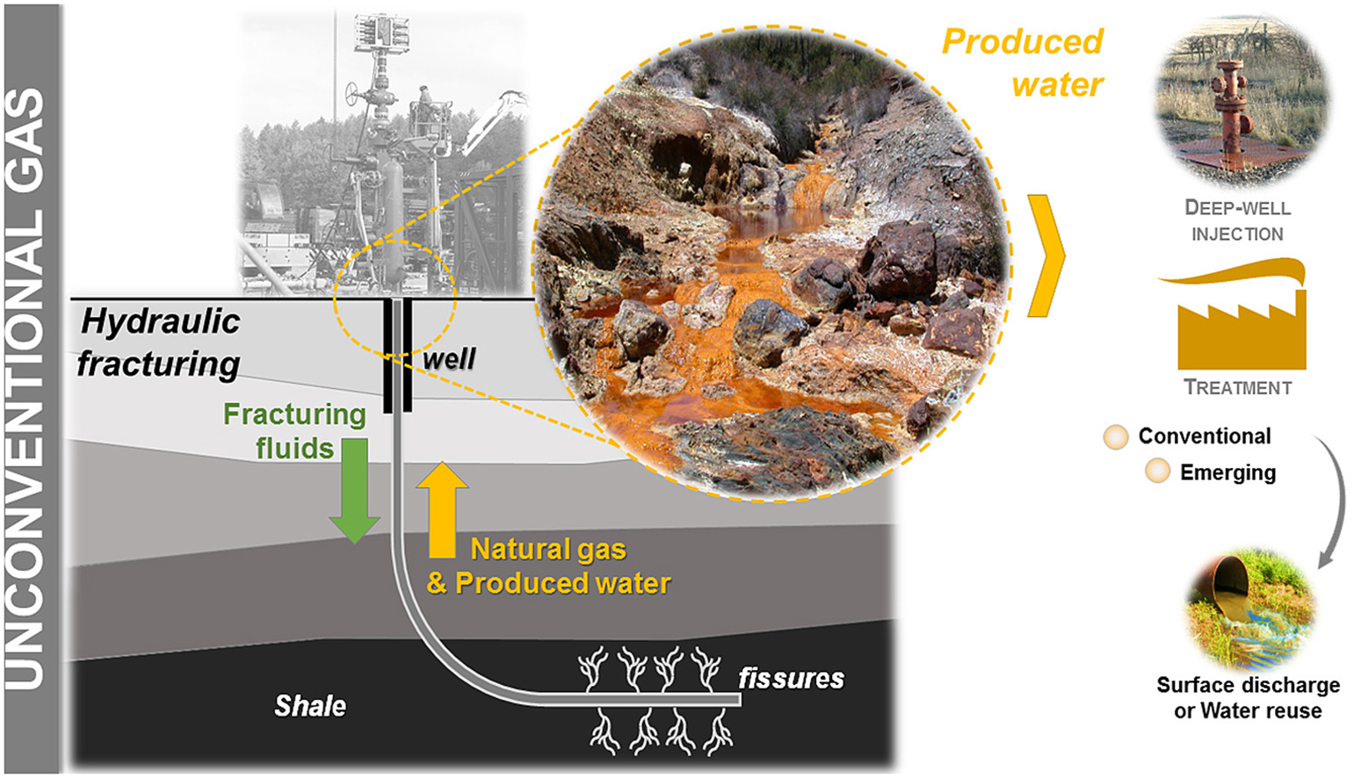
WHAT IS CSG PRODUCED WATER
CSG PRODUCED WATER IS ACTUALLY SALINE GROUND WATER
IN AUSTRALIA CSG WATER CONSIST OF Na, HCO3-, Cl-.
DIRECT DISCHARGE OF CSG WATER WILL IMPACT THE ENVIRONMENT GREATLY

Slide 5
TREATMENT OF CSG PRODUCED WATER
State-of-the-Art Technology for CSG Produced Water Management:
Involves pre-treatment techniques (coagulation, pH adjustment, UF, microfiltration) and reverse osmosis (RO).
RO achieves around 75% water recovery, dependent on water salinity and fouling potential.
RO generates concentrated CSG produced water known as brine .
Techniques for Reducing RO Brine Volume and Extracting Minerals:
1.Efforts to reduce brine volume and extract minerals from CSG RO brine .
2.Example: Recovery of soda ash from CSG RO brine in collaboration with Penrice, GE, and QGC.
3.Sodium-rich brine used to generate sodium hydroxide through membrane electrolysis.

Slide 6
3. Additional Concentration of CSG RO Brine:
High osmotic pressure and scaling potential require further concentration.
Thermal separation processes like multi-effect distillation (MED) and membrane distillation proposed [3].
Thermal energy-intensive processes suitable for integration with solar thermal systems.
4. Solar-Assisted MED Systems:
Solar-assisted MED systems demonstrated for seawater and brackish water desalination [15,16].
Potential to apply solar-assisted MED to concentrate further CSG RO brine not systematically studied yet.
5. Study Objectives and Focus:
Study aims to evaluate UF, RO, and MED technologies at pilot scale for CSG produced water treatment.
Focus on process stability, scaling potential, and optimization of permeate, distillate, and brine chemistries.

Slide 7
MATERIALS AND METHOD FOR PILOT SCALE CSG PRODUCED WATER TREATMENT EVALUATION
1. Pilot Treatment Train:
Pilot treatment train includes UF pre-treatment, RO filtration, and MED.
UF system: Two polyacrylonitrile UF membrane modules (96.6 m2 total area, 25 nm pore size).
RO system: Three brackish water membrane modules (23.7 m2 active area, 99.5% NaCl rejection).
Cartridge filters installed before RO modules for protection.
Pilot MED system designed and built by Sasakura Engineering Co., Japan, with SCADA automation.
2. Experimental Protocol:
UF operated in dead-end mode: 17 min production, 40 s air scouring, 30 s back-flushing.
UF trans-membrane pressure < 0.55 bar to prevent membrane blocking.
Industrial anti-scalant added to UF filtrate before RO.
RO feed flow rate: 1 m3/h, transmembrane pressure set at 17 bar for 76% water recovery.
MED system continuously operated, temperature 70 ± 2 °C, absolute pressure 25 ± 1 kPa.
Anti-scalants added to RO brine for MED: Belgard EV2030 and Accent 1131.
MED feed flow rate: 20 L/h, water recovery set at 80% for an overall recovery of 95%.

Slide 8
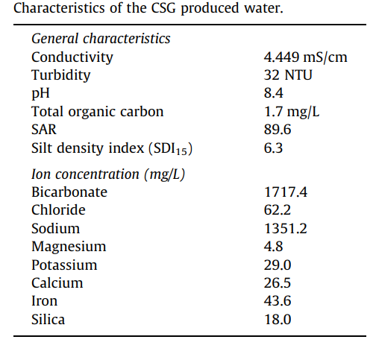
3. ANALYTICAL METHOD
3.2. Anion Analysis:
Ion Chromatography system (LC-20AC, Shimadzu) with Dionex Ion Pac AS23 column.
Eluent: 4.5 mM Na2CO3, 0.8 mM NaHCO3.
Calibration using standards for anions.
3.1. Total Organic Carbon and Bicarbonate:
Shimadzu TOC/TN-VCSH analyser used.
TOC measured after acidification and air sparging.
Bicarbonate concentration calculated using TC, TOC, and pH.
3.3 Cation Analysis:
Agilent 7500 CS ICP-MS used.
Boron, Mn2+, Al2+, Na2+, K+, Mg2+, Ca2+, Fe2+ concentrations measured.
Samples diluted with nitric acid for analysis.
3.4. Other Water Quality Parameters:
Silica (SiO2) concentration measured using Pocket Colorimeter II.
SDI measured for raw CSG water and UF filtrate.
Turbidity measured with Hach 2100Qis portable turbidity meter.
Conductivity and pH measured using Orion star A325 portable pH/conductivity meter.

Slide 9
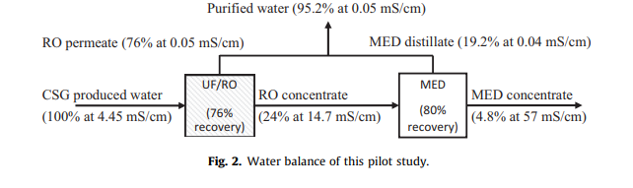
RESULTS AND DISCUSSION
4.1. Water Characteristics:
CSG produced water slightly brackish with dominant sodium (1351 mg/L) and bicarbonate (1717 mg/L).
Other cations and anions concentrations low or undetectable.
Chloride concentration (62.2 mg/L) lower than other CSG fields.
Calcium, magnesium concentrations insignificant due to hydro-chemical processes.
High sodium adsorption ratio (SAR) of 89.6, unusable for irrigation without treatment.
Low organic content (1.7 mg/L), minimal organic fouling.
High turbidity (32 NTU) and SDI15 (6.3) due to iron content
4.2. Water Balance of Treatment Train:
UF/RO process: 76% water recovery.
RO brine to MED: Additional 80% water recovery, total 95%.
Conductivity removal efficiency summarized.
12,000 L of CSG produced water treated in pilot study.

Slide 10
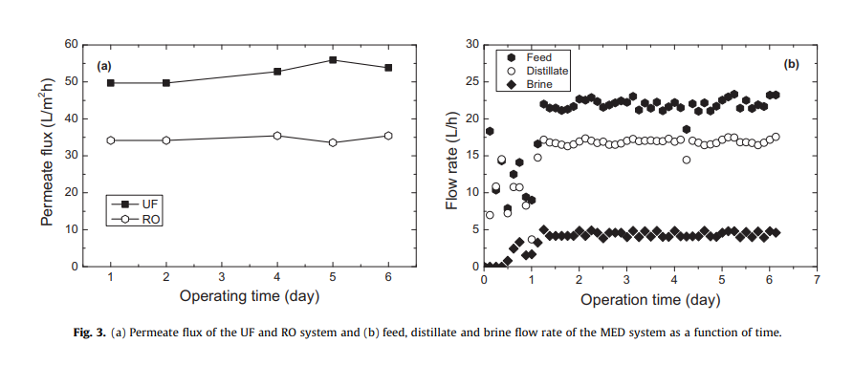
4.3. Process Stability:
UF/RO process maintained stable water production rate.
UF pre-treatment reduced turbidity.
Effectiveness of added anti-scalant to UF filtrate.
MED system fully automated, stable flow rates throughout.
Anti-scalants prevented scaling on evaporative tubes.

Slide 11
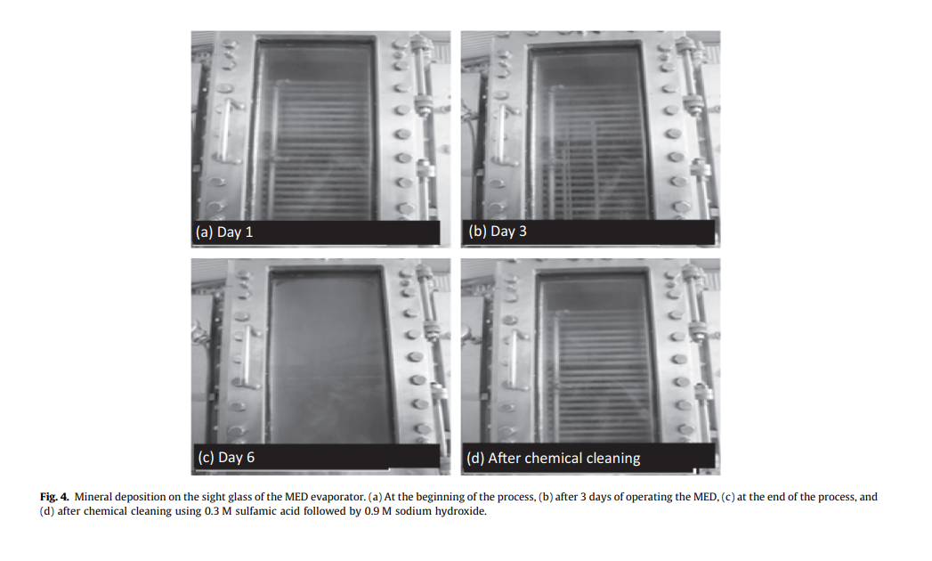
4.4. Scaling Assessment and Chemical Cleaning:
Comparison of measured mineral concentrations with mass balance.
Concentrations of minerals in RO permeate and MED distillate negligible.
Precipitate formation observed on sight glass during MED operation.
Chemical cleaning effectively removed mineral deposition.
Scaling effectively controlled by preventative chemical cleaning.

Slide 12
Conclusion:
Technical Feasibility: Successful demonstration of treating CSG produced water using UF, RO, and MED pilot treatment train.
Water Recovery: Achieved 95% water recovery over a sustained period.
Scale and Process Stability: No evidence of scaling or process instability observed during RO or MED processes.
Inspection Results: In-depth inspection of MED evaporative chamber showed no precipitates on evaporative tubes.
Mineral Precipitation: Mass balance analysis and measurements suggest potential precipitation of calcium, magnesium, and silica.
Visible Deposition: Visible mineral deposition on MED chamber sight glass after 3 days, later removed by chemical cleaning.
Blending Potential: Desalinated water can be blended with UF filtrate to reduce overall energy requirement and condition RO permeate and MED distillate.

Slide 13

THANKS
This study was supported by the National Centre of Excellence in Desalination Australia, with industry support from AGL Energy (Sydney, Australia), Sasakura Engineering Co., Ltd. (Osaka, Japan), and OsmoFlo (Adelaide, Australia). Technical assistance from Mr. Taner Ozdemir and Mr. Wayne Taylor (OsmoFlo) during the study is gratefully acknowledged.

